Slide 1
Competitive Study Application
An Advanced Web Development Project
Danyal Shah
Supervisor: Christos Dexiades

Slide 2
Introduction
A Web Application designed to help students revise for exams
Whilst facilitating their competitive nature
Components
Frontend: Next.JS
Backend: Spring Boot
Database: PostgreSQL

Slide 3
Background
Students are very likely to distract themselves during revision
1
They may also struggle to find one, or get bored easily
2
The idea – provide students with an incentive to make revision fun and return to study
3
Achieved by using their competitive side
4
Turning revision into a competition

Slide 4
How Does It Work?
Student logs into their profile
They can search for a subject to study
Student chooses a topic to study, asked a series of questions
Every incorrect attempt reduces available marks
Marks earned are applied to student’s profile
All marks will appear on a leaderboard.

Slide 5
Competition? Mark Reduction?
From experience, most students love to be competitive
Especially where prizes are involved!
Knowing they lose marks for each wrong attempt, students would want to achieve maximum marks on the first attempt.
More marks = Higher Ranking

Slide 6
Features
Implemented
Account Creation & Logging In
Student Dashboard Prototype
Subjects Selection with Topics
Pending
Questions For Each Topic
Points System
Leaderboard
Admin Profiles
Potentially
Tutor Profiles & Classes
Contests System

Slide 7
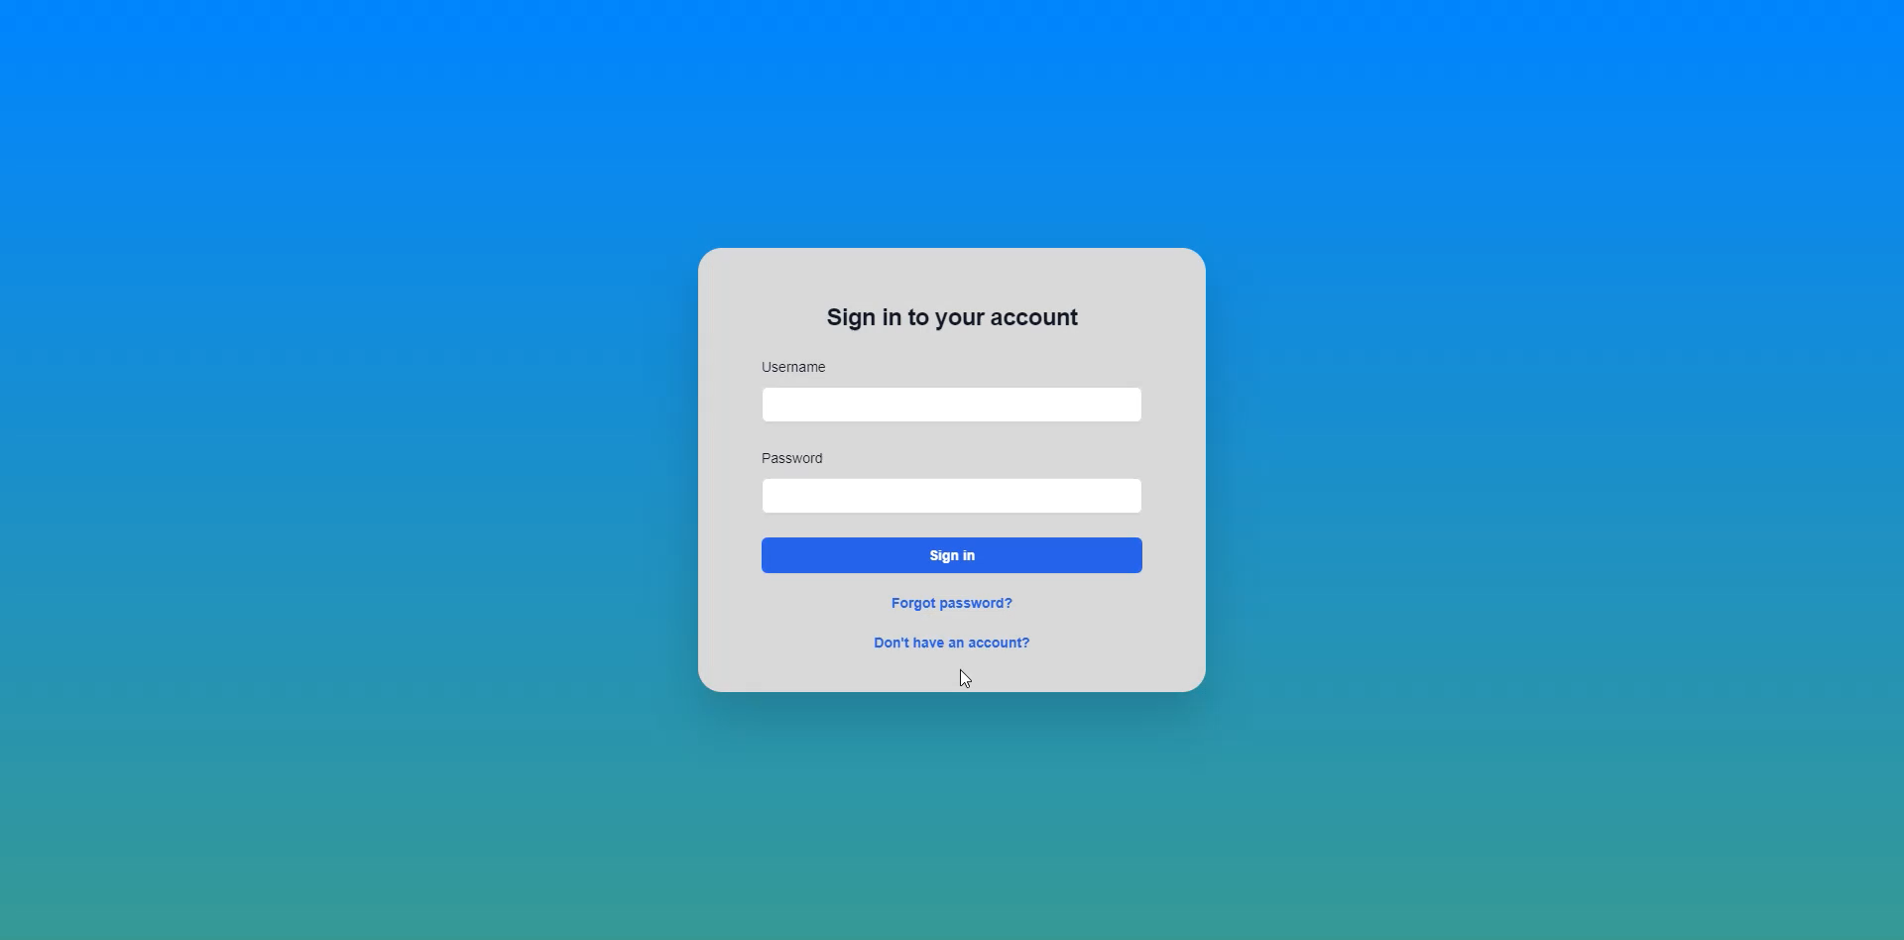
Demonstration

Slide 8
Summary
Purpose: Make studying engaging and competitive for students
Status: Accounts, Subjects & Topics Implemented
Next: Questions for topics - Applying marks to profiles
Goal: Give students an incentive to revise in a way that’s fun for them
And have them come back again in the future to continue revision.

